Slide 1
Presentation

Slide 2
Presentation Topic : “Decentralization of Public Services and Role of Local Government in Bangladesh”
Course Title : Government and Sociology.
Course Code: Hum-2141

Slide 3
Submitted By: Name : Sajib Bhattacharjee ID:20201070010 Semester:2.1 Section: B Date: 19.06.2021
Submitted To:
Name: Shakil Ahmed
Senior Lecturer
Department of Development Studies.
North Western University. Khulna.
North Western University , Khulan.

Slide 4
Decentralization and public services
Many of the proposed benefits of decentralization are based on the premise that it brings local decisionmakers closer to the constituencies they serve. Implicit in this are assumptions about the nature of information available to local decisionmakers, the presence of effective channels for the public to express wants and preferences, and the incentive environment motivating decisionmakers to respond. Each of these assumptions leads to specific conclusions regarding the benefits of decentralization; and taken together, the resulting argument is compelling: local decisionmakers have access to better information on local circumstances than central authorities, and they use this to tailor services and spending patterns to local needs and preferences; the public provides input to local decision making processes and holds local decisionmakers accountable for their actions; and administrative autonomy creates space for learning, innovation, community participation and the adaptation of public services to local circumstances. Classical descriptions of the benefits of decentralization typically follow one or more of these strands (see, for example, Tiebout 1956 and Musgrave 1959).

Slide 5
Most of these assumptions are open to question, however, especially in developing countries. Local authorities, while advantaged by access to information on local circumstances, may be disadvantaged by a lack of access to technical information or to the expert individuals required to interpret it. Channels for the public to express their wants and preferences may be ineffective—and the institutional capacity and incentives for local decisionmakers to respond may be weak anyway—so accountability and participation may remain unchanged. And local administrative autonomy, while providing scope for innovation, learning and local adaptation, might just as easily lead to interest group capture of the decision making process, inadequate attention to equity, inter-jurisdictional free riding, and neglect of public goods. These outcomes, where they occur, can be explained by a variety of theoretical concerns, design-related issues, and social, cultural and political factors. Bardhan and Mookherjee (1998), using a theoretical model of public service provision under decentralized and centralized governments, find that decentralization performs poorly when local authorities are prone to elite capture (inter alia a function of elite group preferences for the good or service in question), when inter-jurisdictional externalities are significant, and when local authorities lack access to necessary information.

Slide 6
Besley and Coate (1999), also using a theoretical model, find that decentralization performs better in the presence of inter-jurisdictional heterogeneities (of language or culture, for example) and worse for goods or services with interjurisdictional spillovers (externalities). Paul (1991) discusses constraints to the use of voice and exit mechanisms—both being theoretical determinants of the accountability and efficiency benefits of decentralized systems—and points to legal and institutional barriers, informational asymmetries, income and education-related factors as constraints to the use of voice, and legal barriers, spatial barriers, monopolistic provision and public good characteristics as constraints to the use of exit.5 Using detailed studies of decentralization and public service delivery in Uganda and the Philippines, Azfar, Kähkönen and Meagher (2001) highlight several reasons why the expected benefits of decentralization have failed to materialize in those countries: namely, that local governments have limited authority and are unable to adjust services, even when they perceive local demands; that citizen influence at the local level is hampered by limited information on the responsibilities and performance of local governments6 ; that exit mechanisms have a limited effect on public service delivery and therefore fail to provide a disciplinary incentive for local authorities;

Slide 7
that local government capacities are generally weak; and that public goods with inter-jurisdictional externalities are particularly vulnerable to deterioration in decentralized settings.7 Litvack, Ahmad, and Bird (1998) also concentrate on the institutional determinants of successful decentralization, pointing out that much of the literature on decentralization assumes the existence of institutions that are very weak in deve loping countries. They illustrate this with reference to voice and exit options and how in developing countries, weak institutions can undermine the effectiveness of both: “Democratic systems are often frail, rendering the electoral system a highly problematic method of achieving accountability. Strong local participation can overcome weak formal election systems, but powerful elites make this difficult in many places. Mobility is often constrained due to poor information, infrastructure and legal frameworks, which result in weak markets for land, labor and capital. Although there is at least some degree of urbanization in all countries, particularly in smaller municipalities and throughout rural areas, it is often unrealistic for a family to sell their land, learn of employment opportunities in other jurisdictions, physically move to the new area, and borrow money in a new locality where they are unknown.

Slide 8
For all their apparent pessimism, none of the arguments in this section constitutes an outright rejection of the value or potential of decentralization. They do, however, highlight the extensive range of institutional preconditions necessary for it to be successful, and they point out areas where special caution is required. Proper institutional design can avoid many of the pitfalls described.
The main issue of practical interest is therefore not whether to decentralize, since this is usually a political decision outside the influence of technical specialists and policy advisors, but rather what to decentralize and how to decentralize it. Both qualitative and quantitative studies can inform these questions. In the next section, we briefly examine the experience of decentralization in the health sector, illustrating points made in this section with examples from the literature. The remainder of the paper concentrates on immunization and the results of our empirical analysis.

Slide 9
Role of Local Government in Bangladesh.
Definition of Local Government:
Local government, in simple words, can be defined as an integral part of central government which is established through locally elected representatives to facilitate welfare activities delegated lawfully. Being a bridge, it connects local people with central government providing services and grants. “It is meant for management of local affairs by locally elected persons. If Government’s officers or their henchmen are brought to run the local government bodies, there is no sense in relating them as local government bodies” (KudratE Elahi Panir vs Bangladesh,1992). It emphasizes on effective participation of local people which can firstly be possible by the arrangement of election in constituting local government.

Slide 10
Furthermore, Duane Lockard defineslocal government as a public organization authorized to decide and administer a limited range of public policies within a relatively small territory that is a sub-division of a regional or national government (Siddiqui, 2005:4). So it is clear that some vested powers of central government are applied by local government in a region only for the benefit of grassroot people.
Importance of Local Government:
Local government established democratically can extend democracy to the lowest level of society. Generally it is set up to implement the policies of central government. Moreover, it creates an opportunity for grassroot people to make their own policies. Thus, democratic local institutions can ensure sustainable development in the society and improve the quality of life. Resources can easily be allocated by local institutions to citizens.

Slide 11
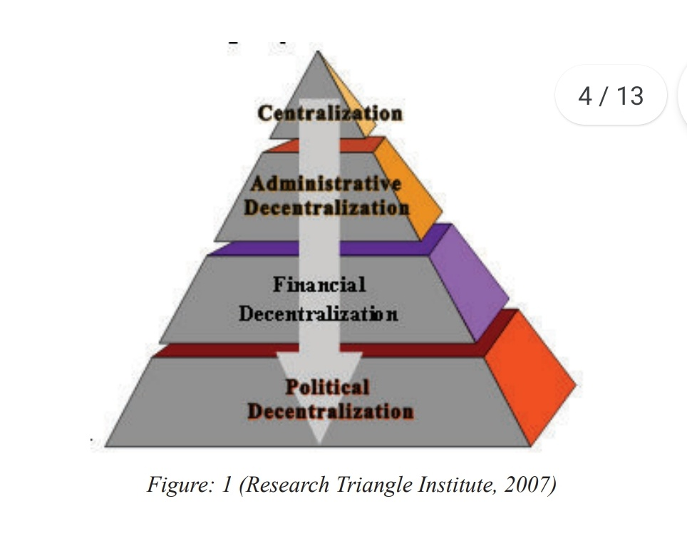
Effective participation of people is possible here in implementing policies or giving opinion or raising voice against the policies and activities of central and local government. In this way accountability, transparency, responsiveness, effectiveness and security can be observed in different governmental system. Due to several dimensions, decentralization refl ects various stages of progress in achieving good governance as outcomes of decentralization.

Slide 12
The above figure shows the actual formula to decentralize the powers and functions from the highest authority to the lowest one. Local government is basically a process of political decentralization, and it should be done in a democratic way; otherwise, the benefit of decentralization will always be inaccessible. Political decentralization can fully be effective if the rest two components of the above figure are added at a time. These can together enhance and fulfill the objectives of establishing local government. But functions and performance of local government can be different according to laws of the countries. But there are some factors which are widely considered as the functions of local government, such as, ensuring potable water, sanitation, solid waste collection, roads, public markets, public transport, primary and secondary schools, housing, health care, and other major economic activities etc. To verify the functions and accountability of local government, some indicators may be considered. These include availability of budgets and financial reports of local government jurisdiction to councilors, the public and media existence of internal and external auditing in accordance with required schedules, existence of a citizen complaint mechanism and use of input,

Slide 13
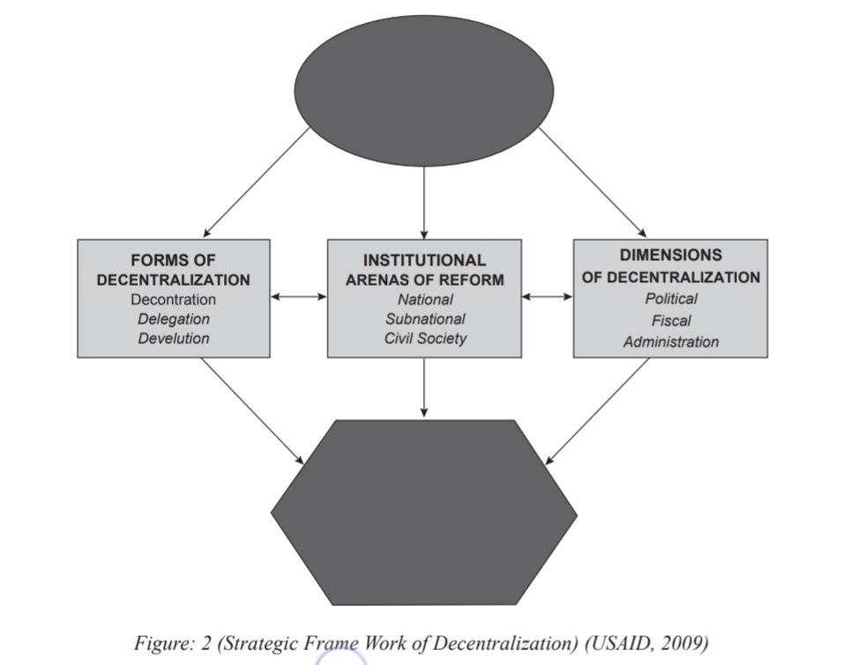
response time for citizen complaints, increased level of monitoring of corruption, human rights violations, minimum wage, health rights for workers, existence of transparent financial systems and full reporting to citizens, documented performance standards and systems of measurement, actual performance reported to public and local government measurement of citizen satisfaction (Henry, Barnett, Van Sant, 1997: 19). The objectives, ways , areas and characteristics of decentralization can be shown by a strategic framework of United States Agency for International Development (USAID).

Slide 14
Among different forms of decentralization stated in the figure, devolution stands out as the best and it refers to the transfer of functions or decision making authority to legally incorporated and elected local government bodies (Siddiqui, 2005: 23-24). Though de-concentration also denotes the transfer of power to local institution, it is done within the government office. In this process central government can exercise full control over that office. On the other hand, delegation is involved for the same with less control of central government. So what we want actually and the obligation incorporated in our Constitution regarding local government may only be the result of devolution.
Conclusion:
Local Government is a system which requires collective efforts of all stakeholders, both local and international, to address the bias of development as a result of centralized governance.

Slide 15
Administrative decentralization is a must to fl ourish democracy in Bangladesh. Besides, local government can ensure good governance in root level. Various policies, activities and functions are here taken and performed by local government on the basis of necessity of grassroot people, not depending upon the wish of policy makers of central government. So it can easily ensure sustainable development in all aspects. Local government through decentralization process can also play a vital role to connect the central government with local people. So, it is our great expectation that the government shall take initiatives to fulfi ll the constitutional mandate to establish local government in all administrative stages of government.

Slide 16
Thank You
The end

